Slide 1
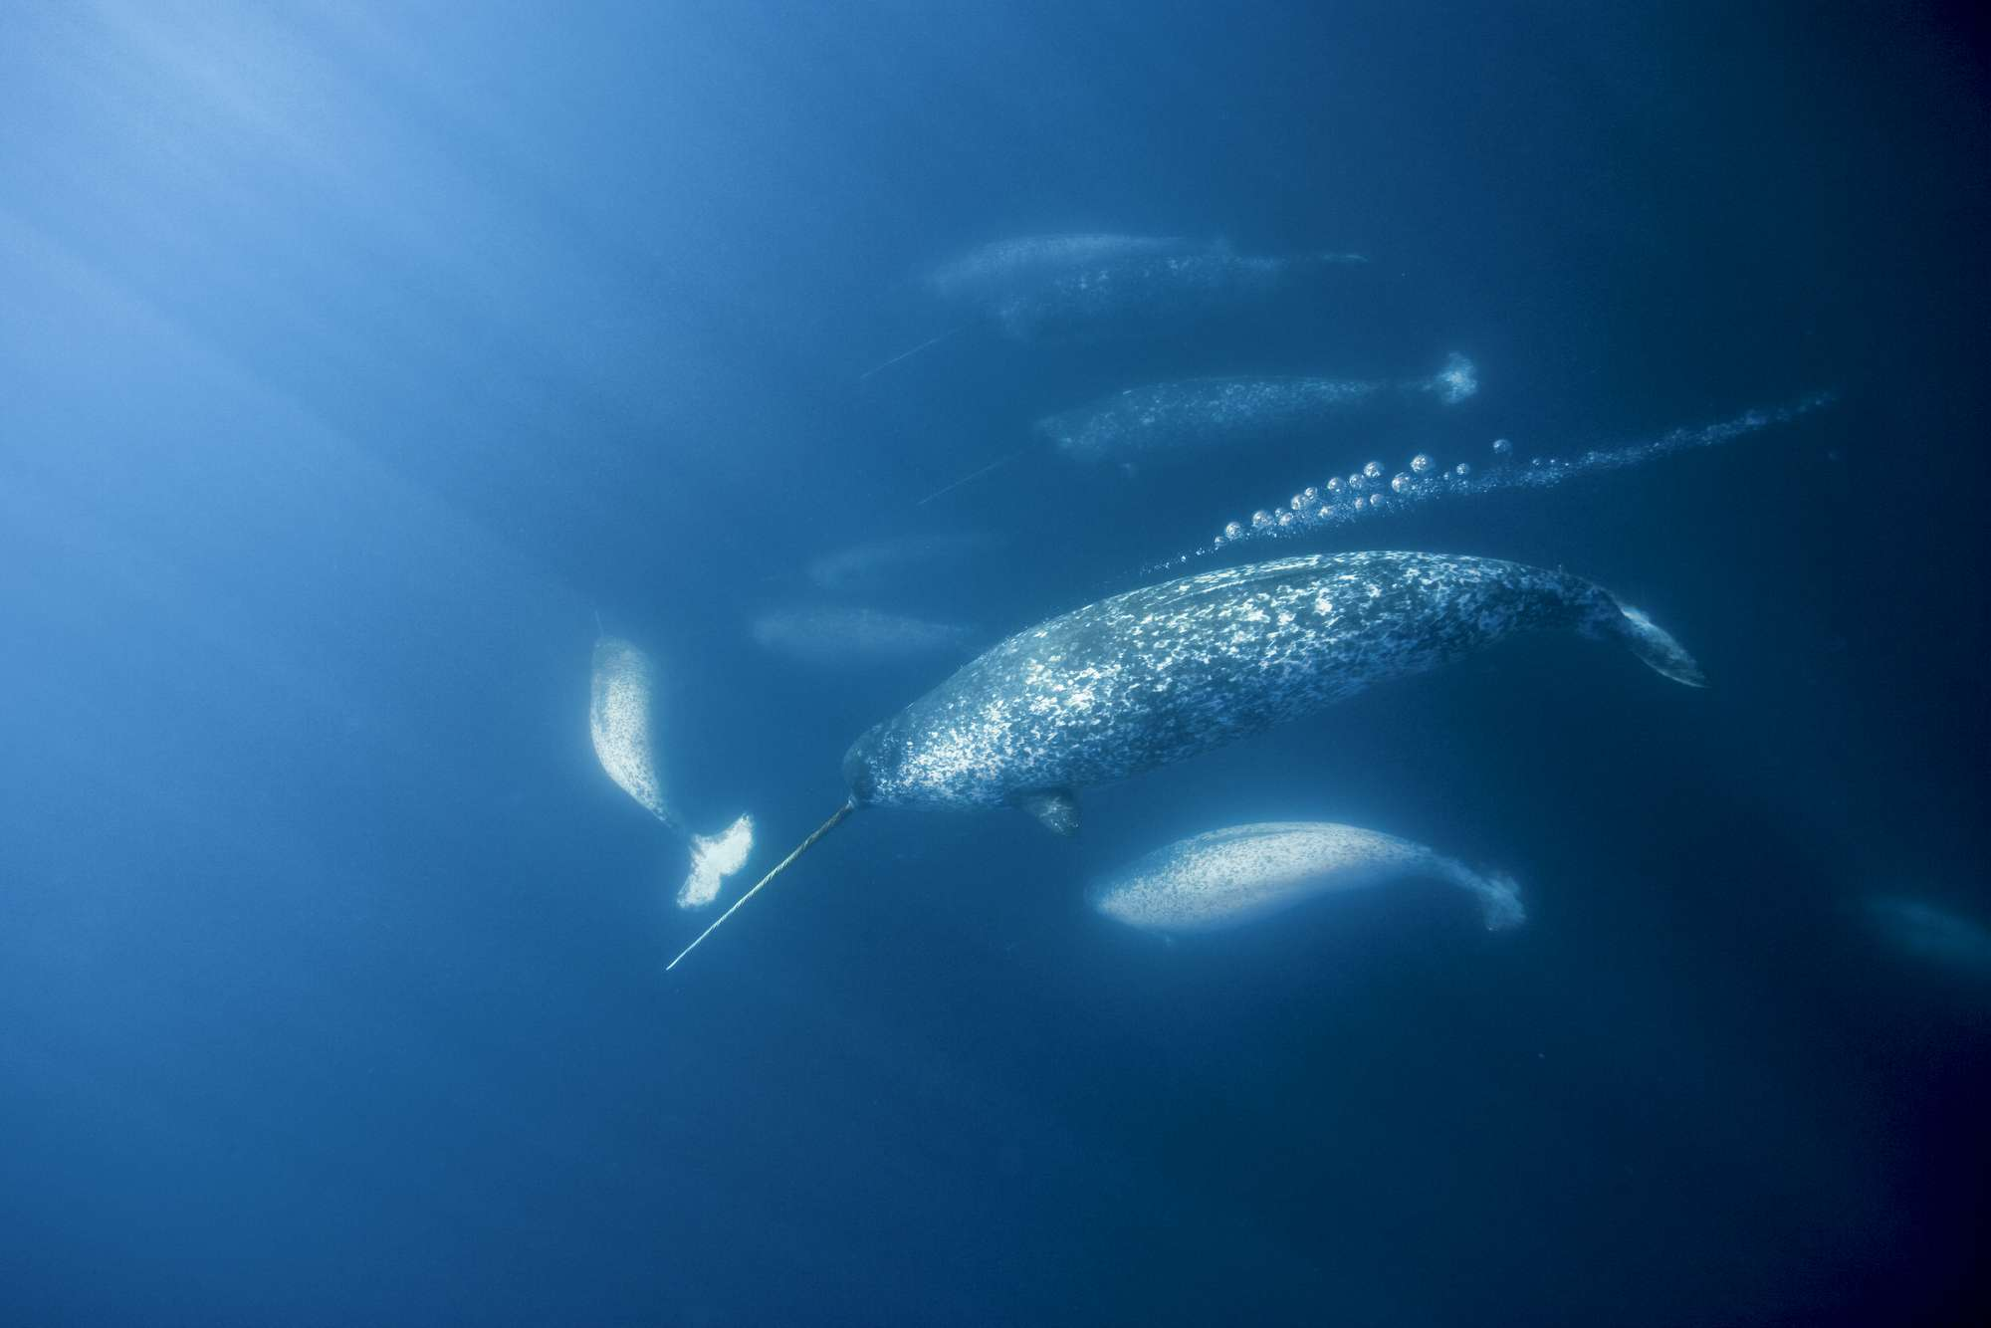
HMM FOR ANIMAL MOVEMENT TUTORIAL
Marie Auger-Méthé and Fanny Dupont

Slide 2
HMM OUTLINE
Ecological motivation
Statistical framework
Narwhal case study
HMMs
CRWs
Notes:
In this presentation, I will briefly discuss the Ecological motivations for HMMs, their statistical framework, in which mixture models and Markov chains combine to make HMMs.
I conclude the talk by presenting the narwhal case study that this workshop is based on.
This workshop

Slide 3
Motivation

Slide 4
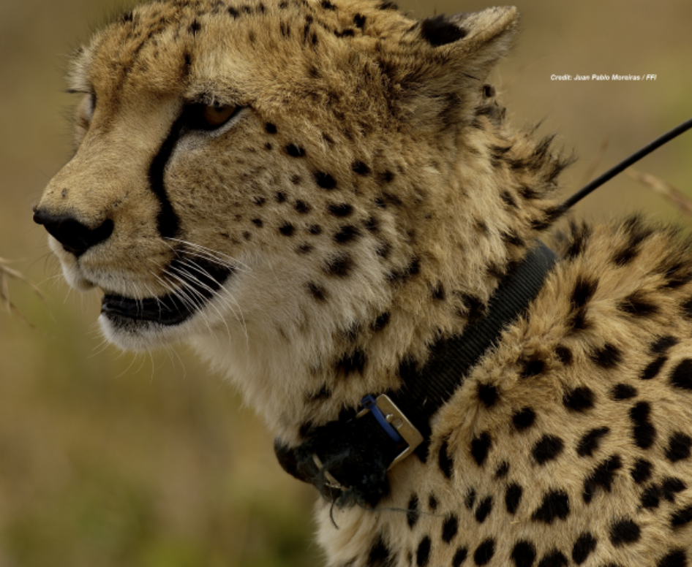
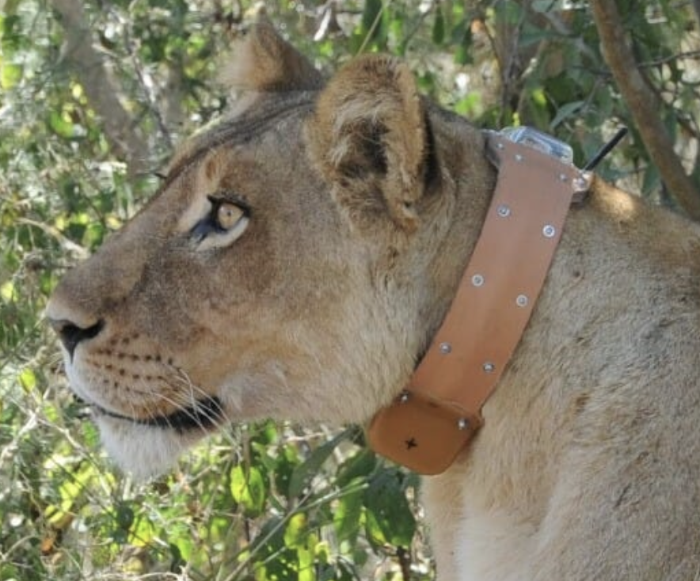
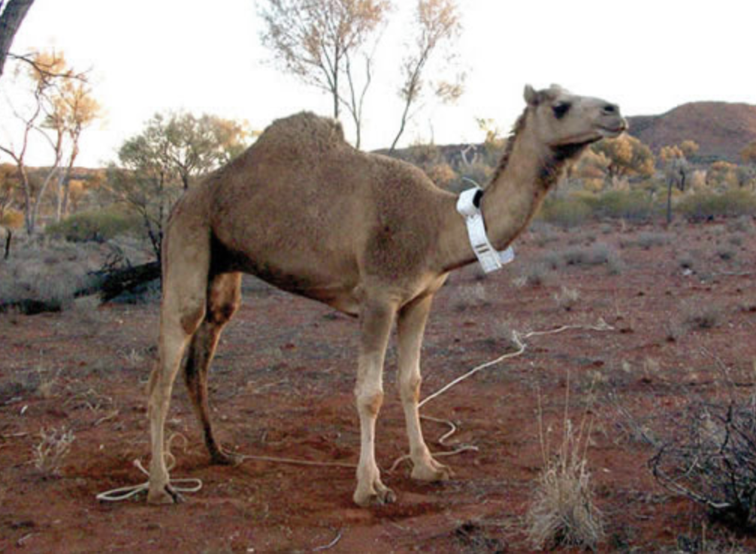
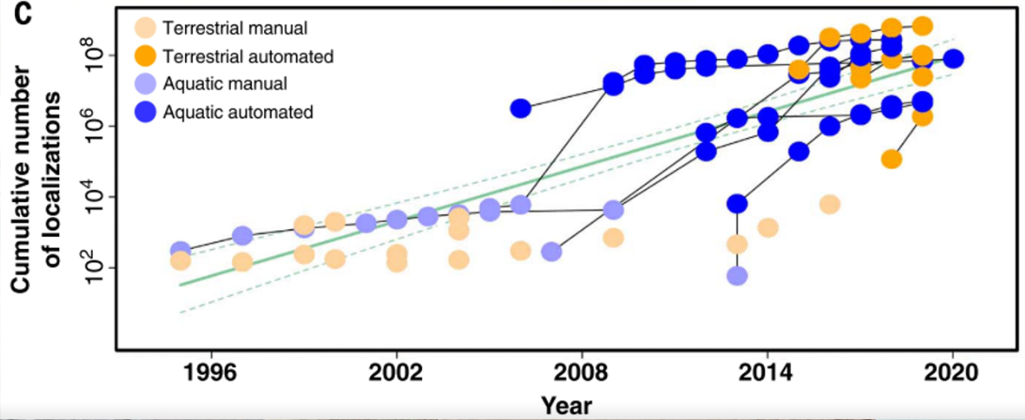
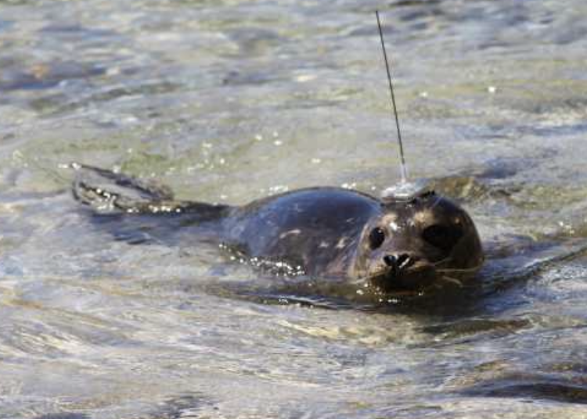
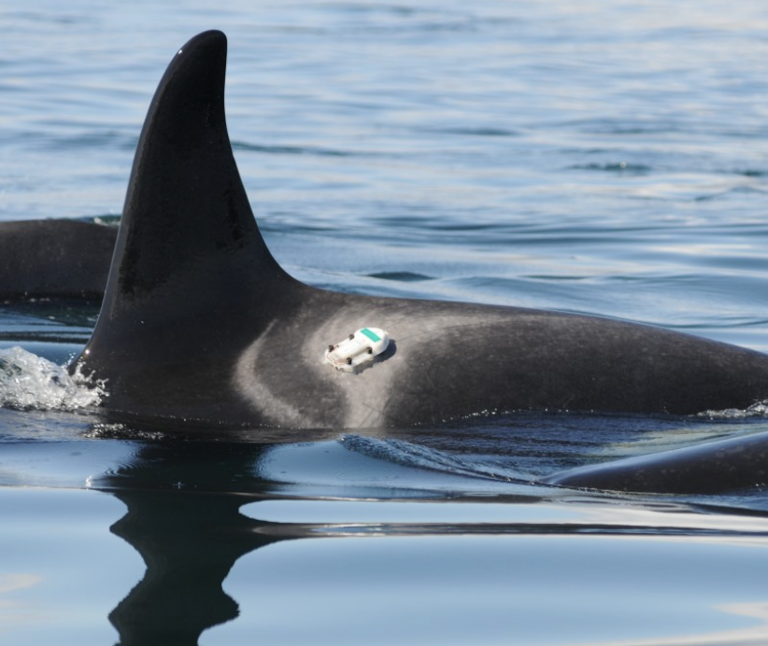
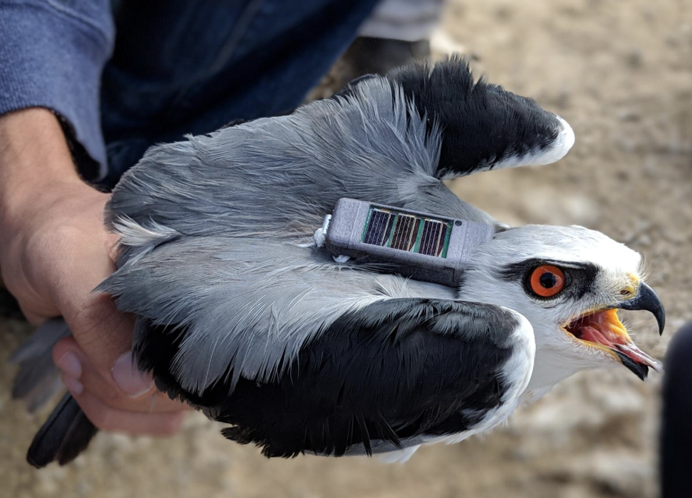
Nathan, R., Monk, C. T., Arlinghaus, R., Adam, T., Alós, J., Assaf, M., ... & Jarić, I. (2022). Big-data approaches lead to an increased understanding of the ecology of animal movement. Science, 375(6582), eabg1780.

Slide 5
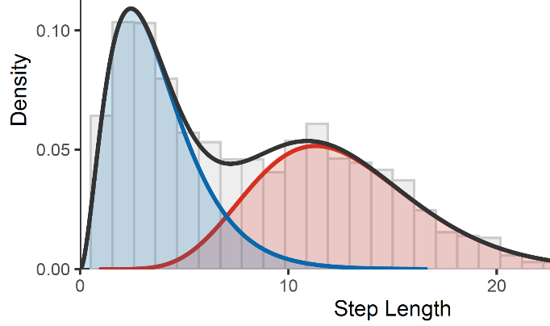
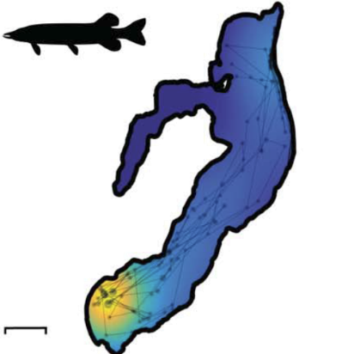
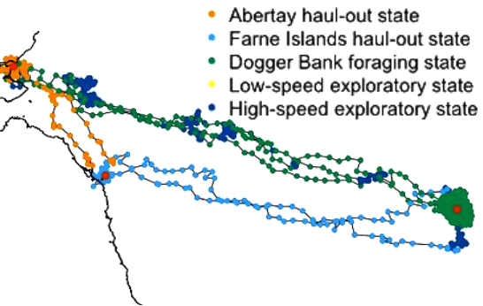
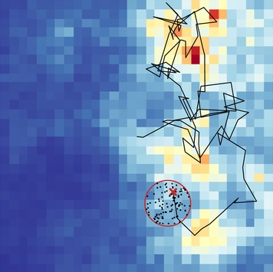
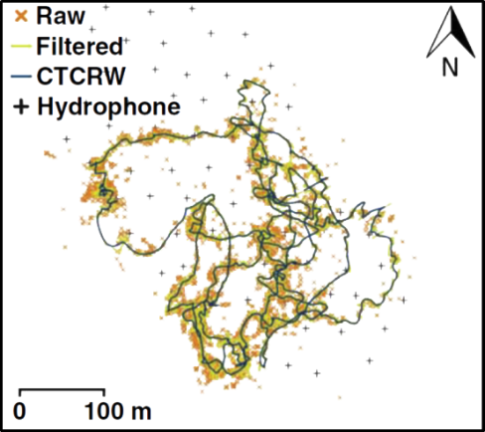
Movement modelling
i
Movement parameter estimation
Nathan et al, 2022
Home range estimation
Behaviour segmentation
Habitat & resource selection
Michelot et al. 2017
Path reconstruction
Michelot et al. 2017
Nathan et al, 2022

Slide 6
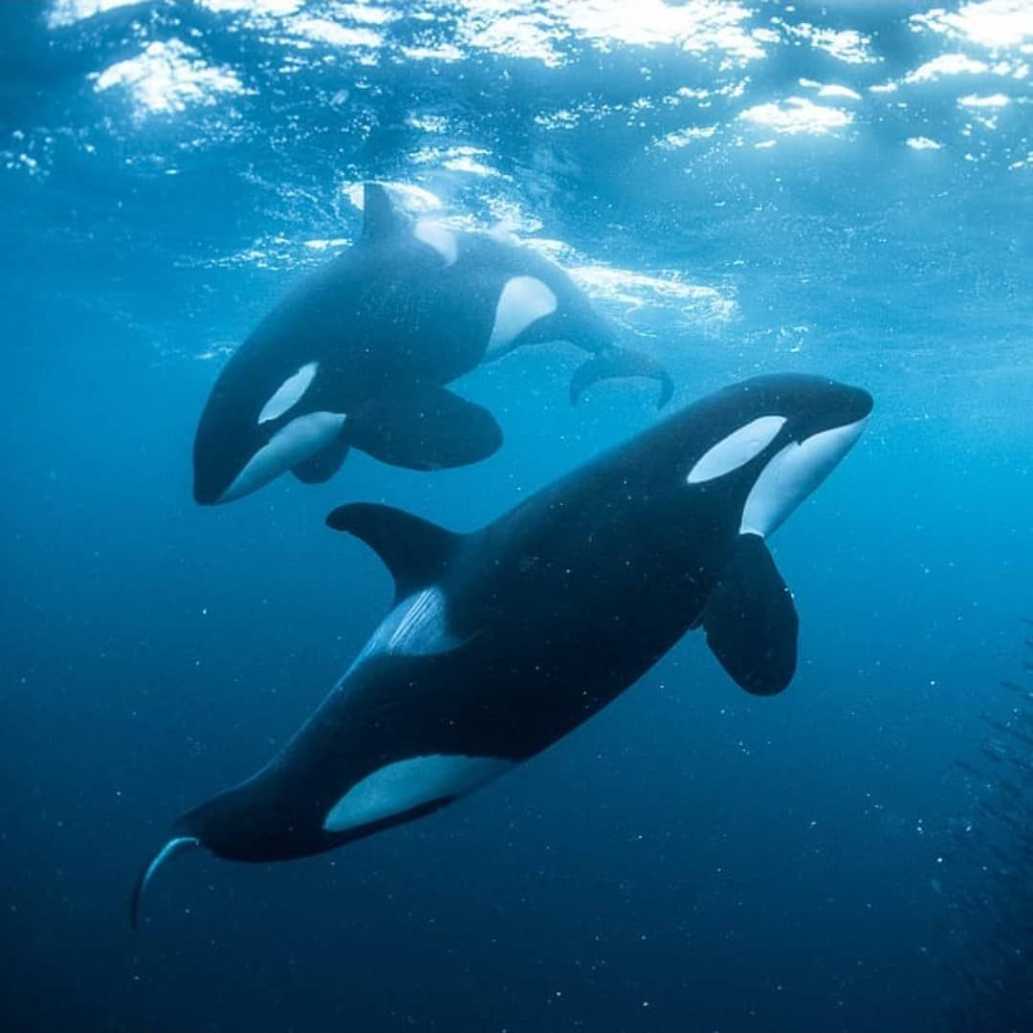
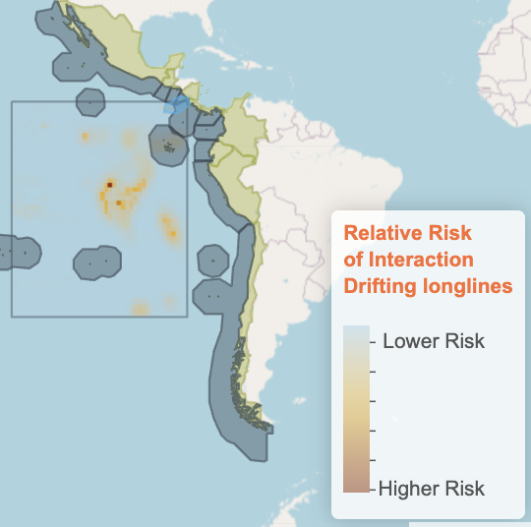
Why behaviour ?
Energy Expenditure
Conservation studies
McRae et al. 2024
Barbour et al. 2022

Slide 7
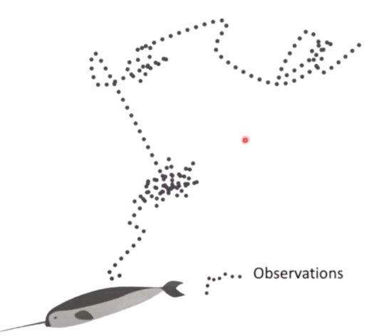
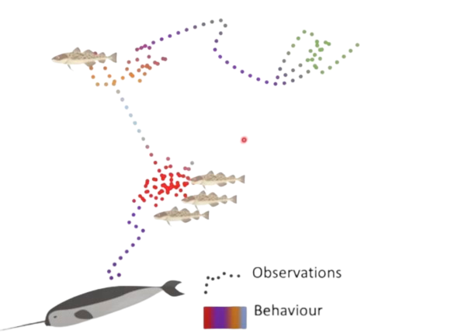
Hidden Markov models: motivations
Underlying biological process is hidden
Observation is conditional on latent process
Behaviour state vs location data
Notes:
So hidden Markov models have two components addressing two fundamental challenges when using telemetry data to identify behavioral states.
The first challenge is that the underlying biological process that researchers are interested in is not directly observed.
That is, the data stream we obtain is an indirect measure of that underlying behavioral process,
Such that observation data conditionally dependent on a latent state process.
For example, if me use catch data to estimate the stock size of a fish species, the true population is hidden. a second example, and the primary focus of this Workshop is using observed movement data to infer an unobserved (or latent) animal behaviour
The second challenge is that latent state process is also autocorrelated in time.
For example, the stock population size in one year is partly dependent on the population in the previous year,
and animal behavior at one time depends on what it was doing previously.
In effect our observation data is autocorrelated through a latent state process.

Slide 8
Hidden Markov Models

Slide 9
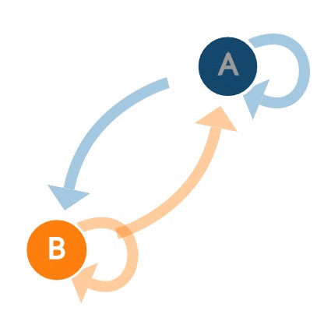
Hidden Markov models - Solution
Underlying biological process is hidden
Finite mixture model
Latent process is autocorrelated
Markov chain

Slide 10


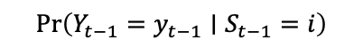
Hidden Markov models – Framework
S
𝚪
S
𝚪
S
t-1
t
t+1
$$Pr\left(Y_{t−1}=y_{t−1}∣S_{t−1}=i\right)$$
$$Pr\left(Y_{t}=yt∣S_{t}=i\right)$$
$$Pr\left(Y_{t+1}=y_{t+1}∣S_{t+1}=i\right)$$
Y
Y
Y
t-1
t
t+1

Slide 11
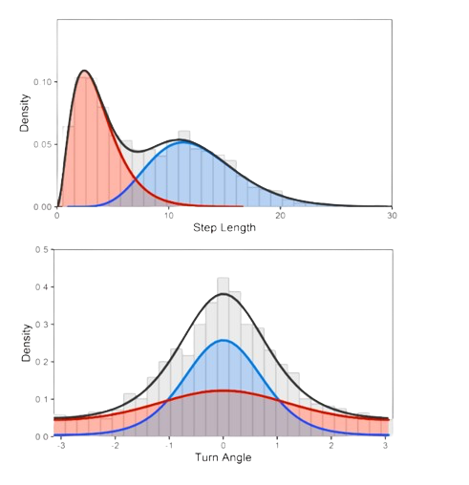
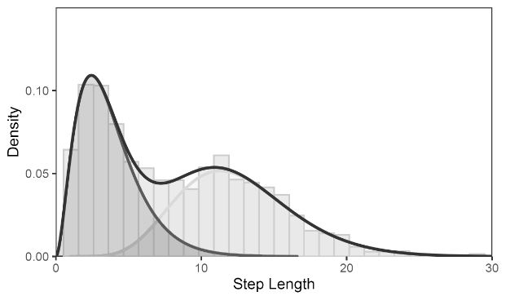
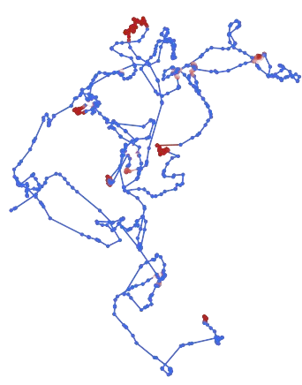
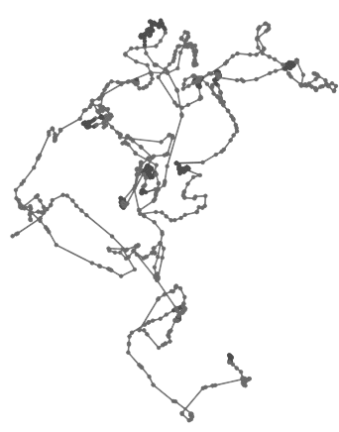
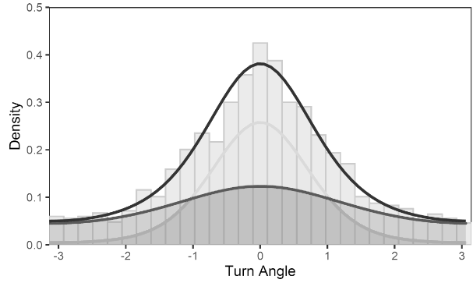
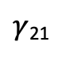
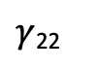
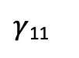
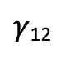
Hidden Markov models – 2 states
$γ$₁₂
$γ$₁₁
$γ$₂₂
$γ$₂₁

Slide 12
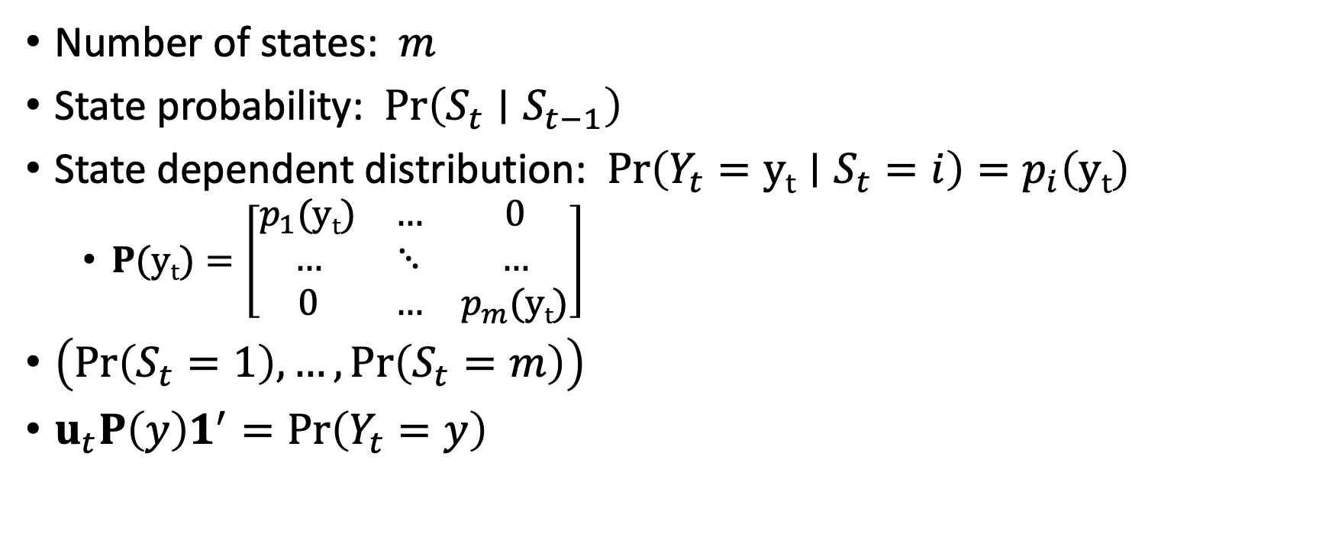
HMM: Key parameters
Number of states: $m$
State probability: $Pr\left(S_{t}∣S_{t−1}\right)$
State dependent distribution: $Pr\left(Y_{t}=yt∣S_{t}=i\right)=p_{i}\left(yt\right)$
$P(yt)=\left[\begin{matrix}p_{1}(yt) & … & 0 \\ … & ⋱ & … \\ 0 & … & p_{m}(yt)\end{matrix}\right]$
$\left(Pr\left(S_{t}=1\right),…,Pr\left(S_{t}=m\right)\right)$
$u_{t}P\left(y\right)1^{′}=Pr\left(Y_{t}=y\right)$

Slide 13
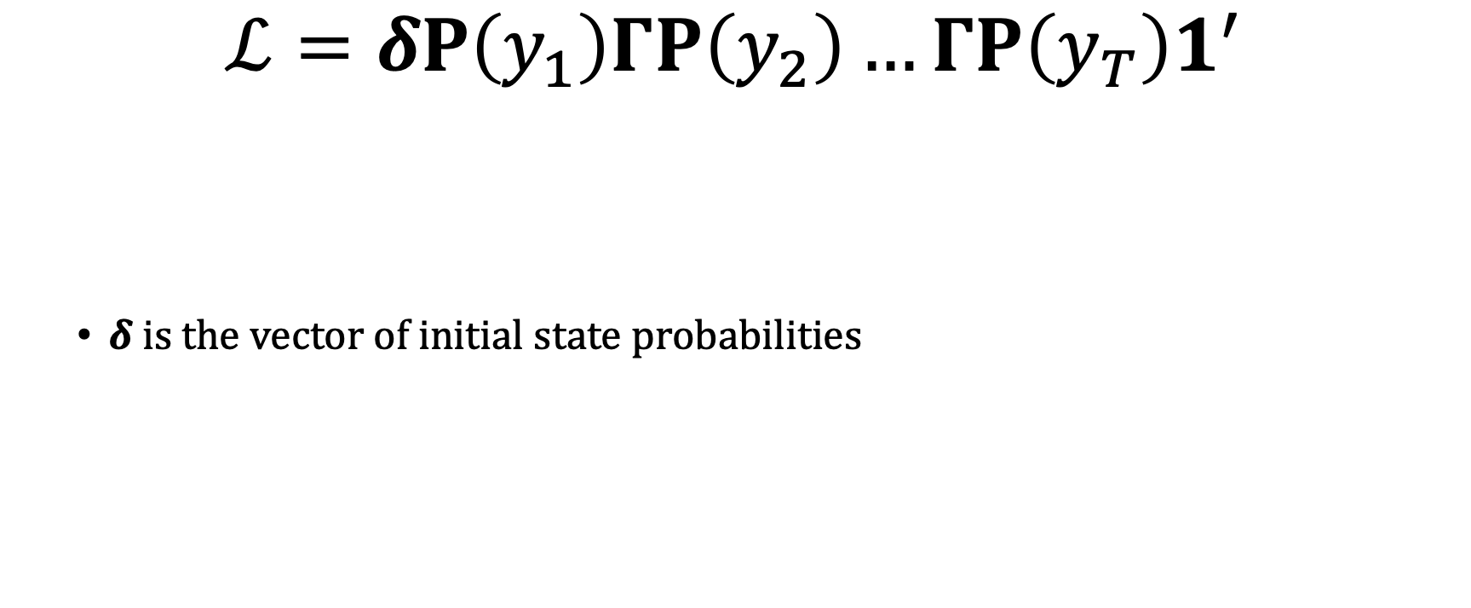
HMM: Likelihood
$$ℒ=δP\left(y_{1}\right)ΓP\left(y_{2}\right)…ΓP\left(y_{T}\right)1^{′}$$
$δ is the vector of initial state probabilities$

Slide 14
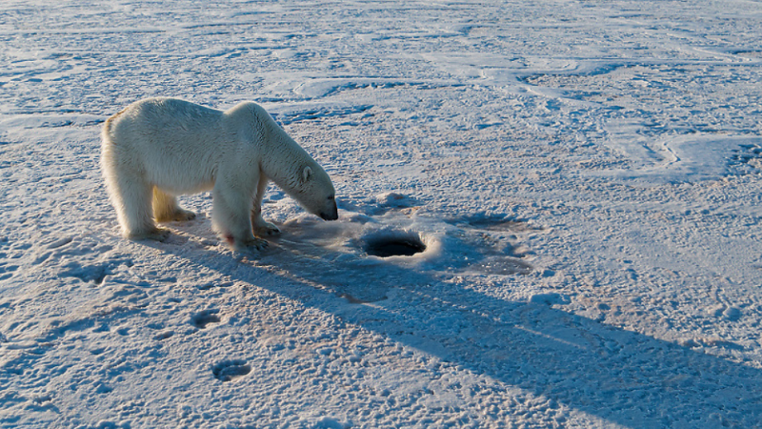
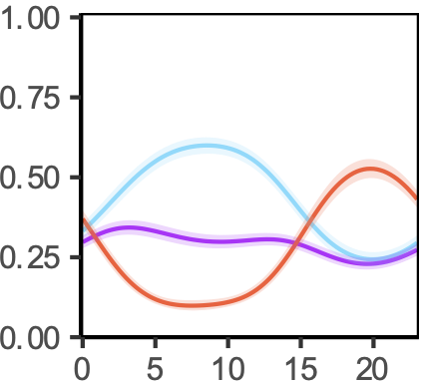
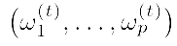
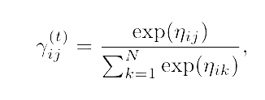
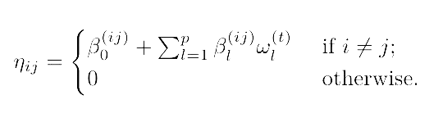
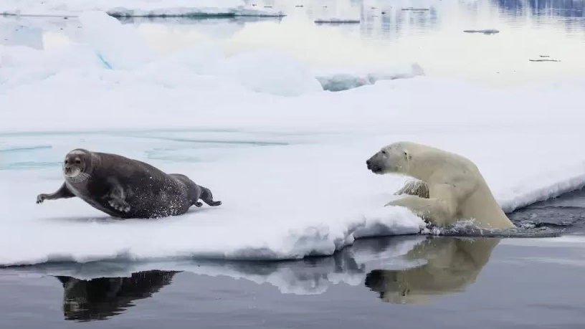
Covariates – hidden process
affect the probability that the animal is in a certain behaviour
©Jami Tarris
Covariates :
State Probability
Hour
Togunov et al. 2022
© Theo Allofs

Slide 15
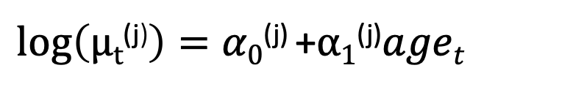
Covariates – observation process
affect the movement
Example: different speed per category of age:
$log\left(μt\text{(}\text{j}\text{)}\right)=α0\text{(}\text{j}\text{)}$+$α1\text{(}\text{j}\text{)}aget$

Slide 16
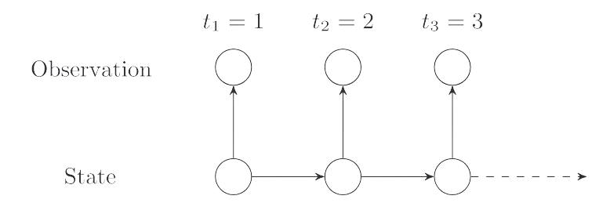
HMMs – Assumptions
HMMs assume regular time intervals between data row
Auto-correlation in the hidden process suffices to characterize the
autocorrelation of the movement.

Slide 17
Correlated Random Walks (Crws)

Slide 18
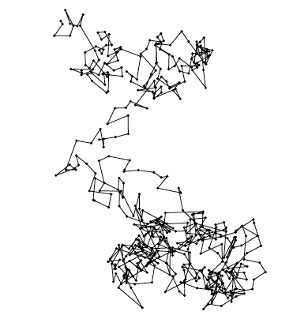
Persistence in direction: CRWs
Simple random walk
Multi-state correlated random walk
Correlated random walk
Michelot et al. 2018

Slide 19
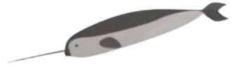
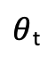
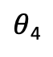
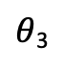
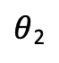
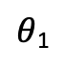
Movement data-streams: step-length and turning angle
Observed step-length
l_{t}
Observed turning-angle
$θ$_{t}
l₀
X₀
$θ$₄
X₄
X₃
l₄
$θ$₁
l₃
$θ$₃
l₁
X₂
l₂
X₁
$θ$₂

Slide 20
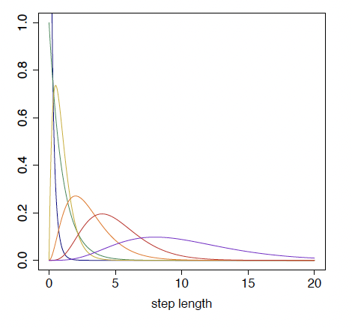
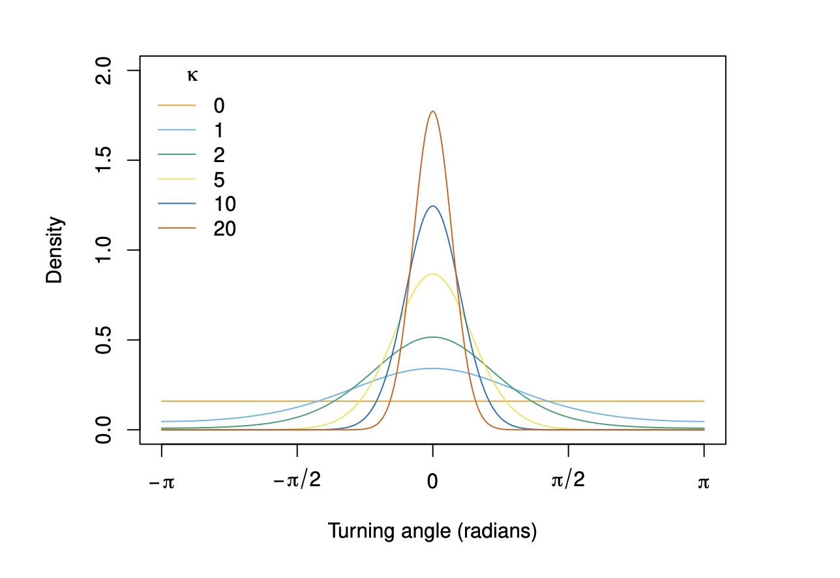
Modelling step-length and turning angle:
gamma distribution
Von Mises distribution

Slide 21
NARWHAL CASE STUDY

Slide 22
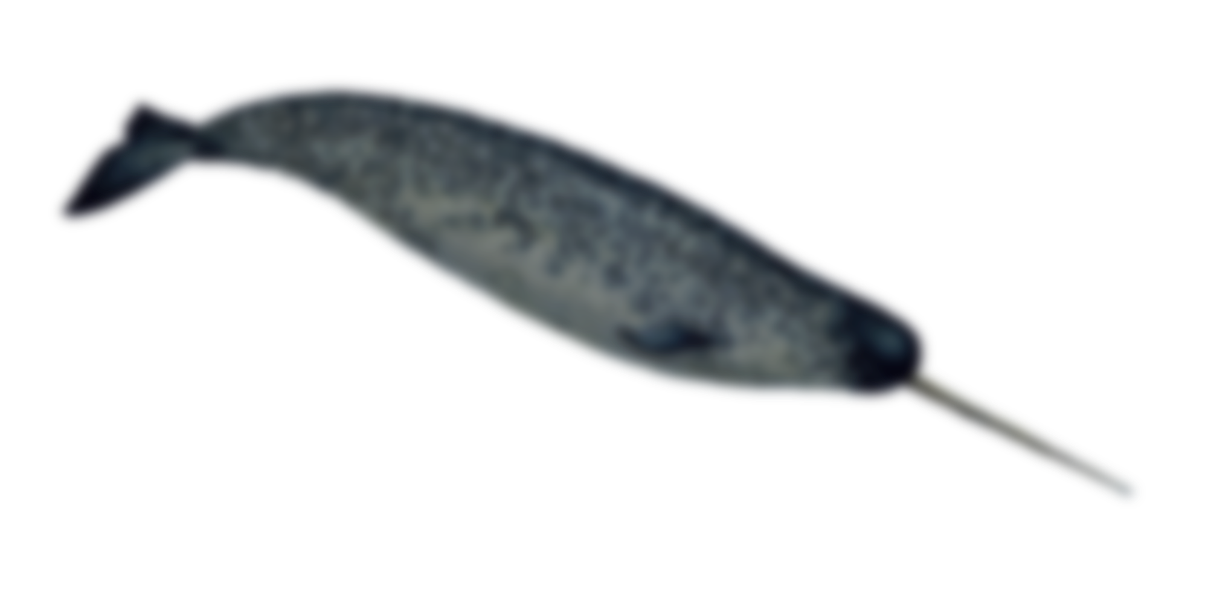
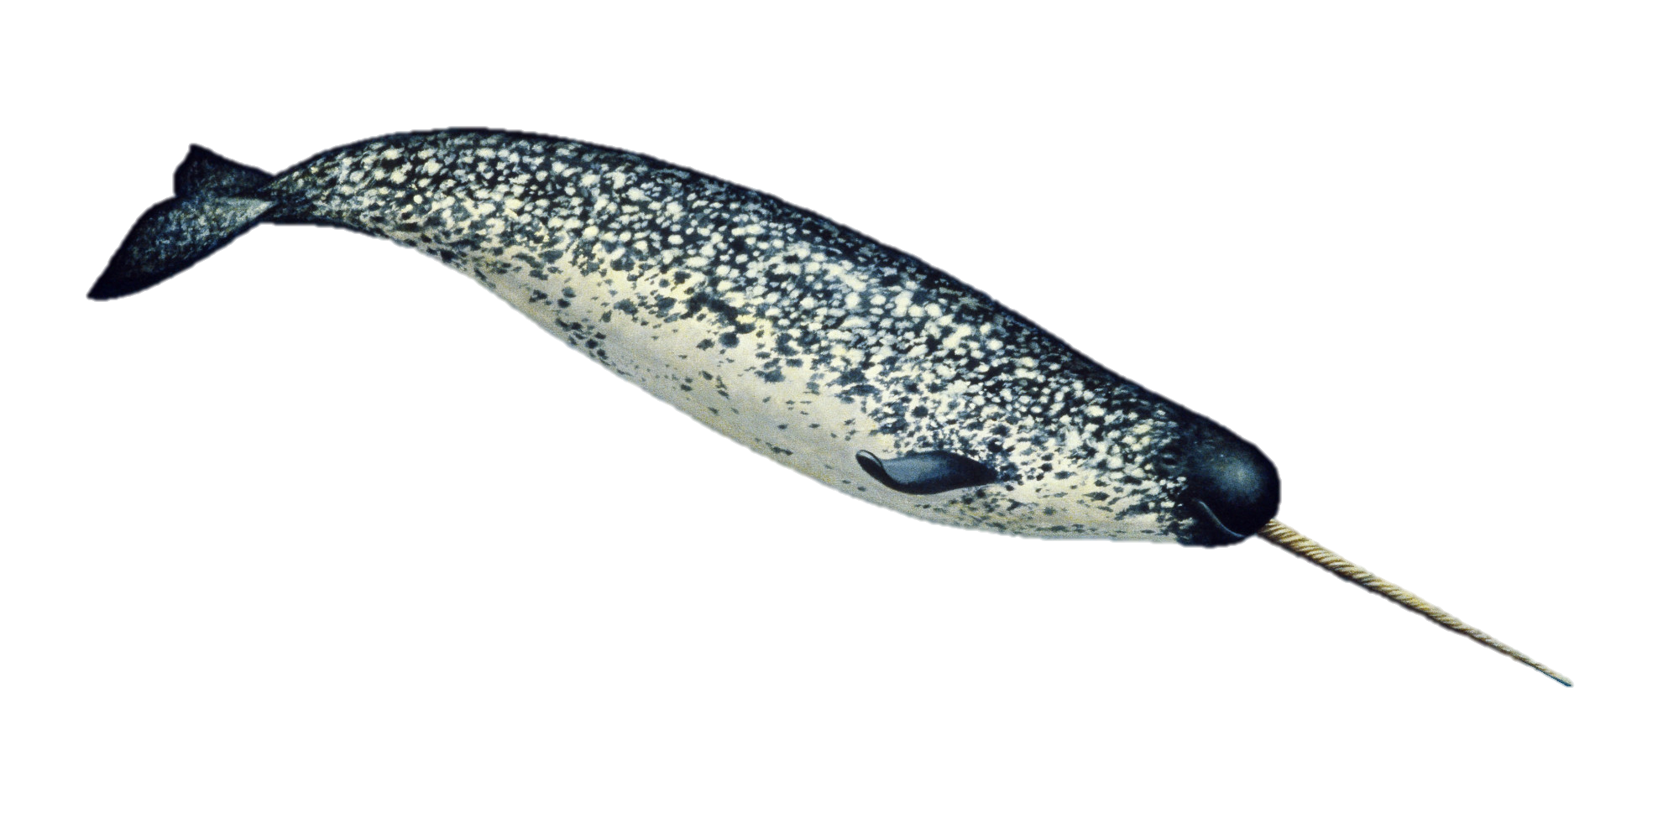
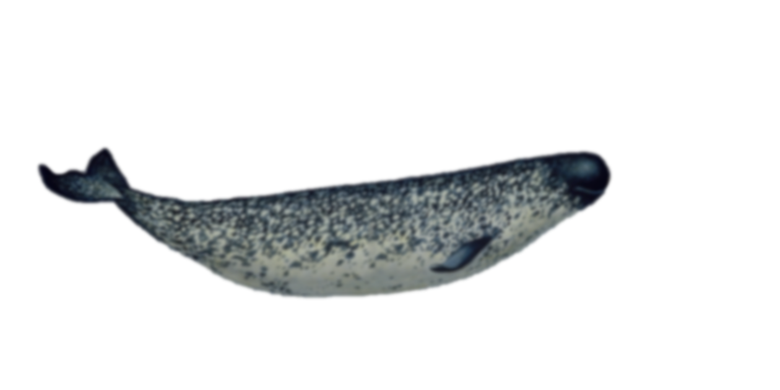
1. Narwhal data
Three Narwhals tagged in Tremblay Sound
Fastloc GPS location data
Raster of bathymetry
Temporal resolution:
Fastloc GPS: 10 min

Slide 23


Polar bear exercise

Slide 24

2. Polar bear data
One polar bear collared in the Beaufort Sea, in April of 2009
One year GPS locations
Temporal resolution:
1 hour

Slide 25

Tutorial’s objectives
Fit simple HMMs using momentuHMM
Checking model fit
Incorporating and interpreting covariates on behaviour transition probabilities
Incorporating covariates in the observation model
(Bonus)
Select an appropriate resolution for the data
Handle missing data

Slide 26
1. Fitting HMM with momentuHMM
Package by Brett McClintock and Théo Michelot, based on moveHMM
Key functions
prepData – prepare tracking data for fitting HMM
Extract environmental data
Calculate step length and turning angle
Calculate circular covariates (e.g., angle relative to ocean currents)
fitHMM – Define HMM structure and fit it to model
Number of states
Distribution associated with each state
Starting parameters
Covariates

Slide 27
prepData(data, type = "LL", coordNames = c("lon", "lat"))
Minimum arguments:
Data (e.g., data = sealreg)
Type - coordinate reference system (“UTM” if not lat/long)
coordNames - names of coordinate columns (if not c(“x”, “y”))
Optional arguments:
covNames – names of covariates (fills in missing data with nearest value)
spatialCovs – raster object from which to extract covariate data
angleCovs – name of angular covariate for which to calculate the relative angle (e.g., turn angle relative to wind

Slide 28

fitHMM(data, …)
Minimum arguments:
nbState – number of behavioural states
Dist – named list distribution associated with each data stream
E.g., gamma for step length and von Mises for turning angle
dist=list(step="gamma", angle="vm")
Par0 – named list initial parameters for data optimisation
E.g., step length l ~ gamma(μ_{i},σ_{i}), define μ and σ for each state
Par0 = list(step=c(mu0, sigma0), angle=kappa0)
Par0 = list(step=c(c(200,500), c(100,250)), angle=c(0.5,0.8))
ϕ
l

Slide 29

fitHMM(data, …)
Optional arguments:
Formula – effects of covariates on transition probability
E.g., formula= ~bathy
estAngleMean – Whether to estimate mean turning angle (default=F)
circularAngleMean – Whether to use a circular-circular distribution for turn angle (use if examining bias relative to multiple factors or if expect non-linear relationship; default = circular-linear)
stateNames – names associated with each behavioural state
retryFits – number of times to attempt to fit the model
DM, workBounds, betaCons, fixPar, …

